Slide 1
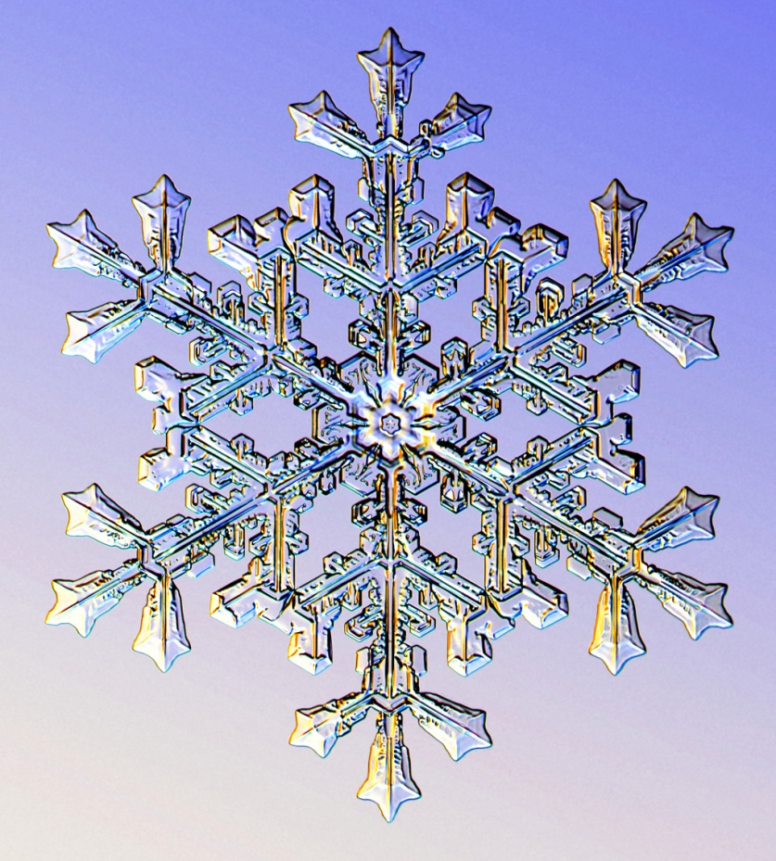
Snowflake Identification with Children
Madeleine Baisburd
* All photographs of snowflakes credited to Kenneth Libbrecht from his educational website, SnowCrystals.com *

Slide 2
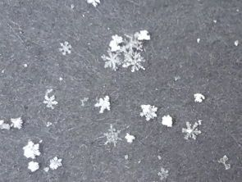
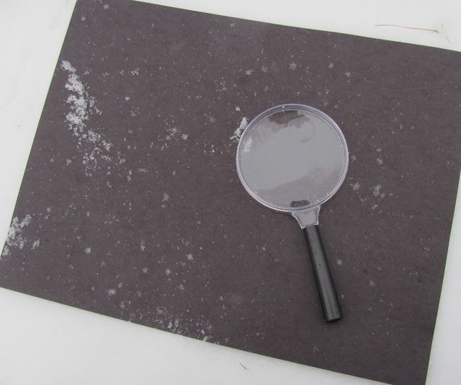
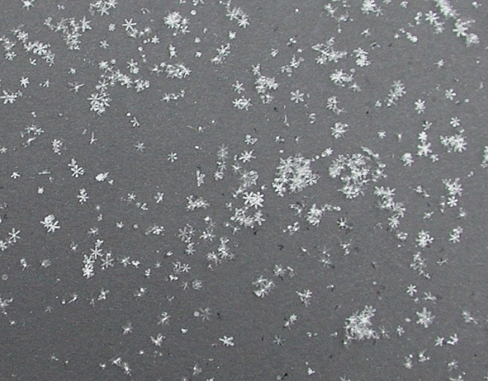
Step 1: Make Snow Catchers
- Construction Paper, Fun Foam, Felt, Cardboard; can become a craft of its own!
***Make sure your snow catcher has been frozen!!

Slide 3
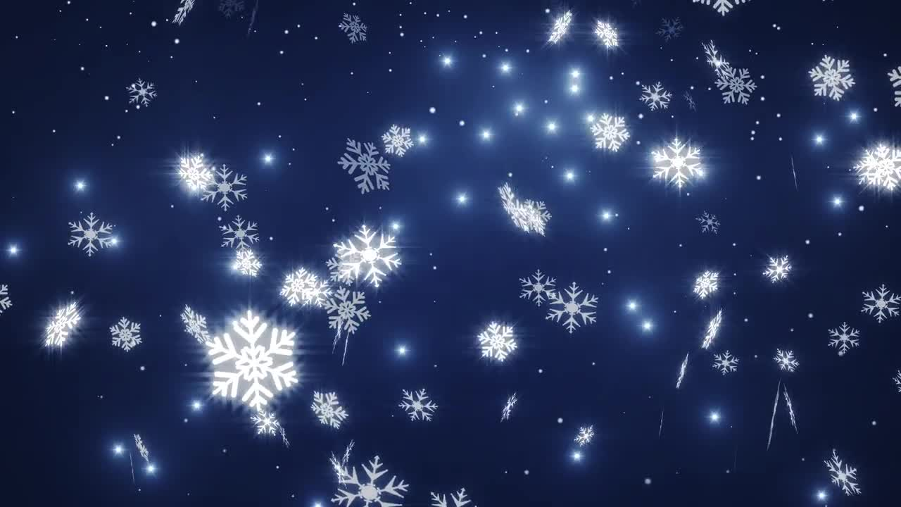
Step 2: Wait for Falling Snow
- Ideal without wind; can try snow from the ground but more likely the crystals will be broken or compacted; can become an interesting comparison!

Slide 4
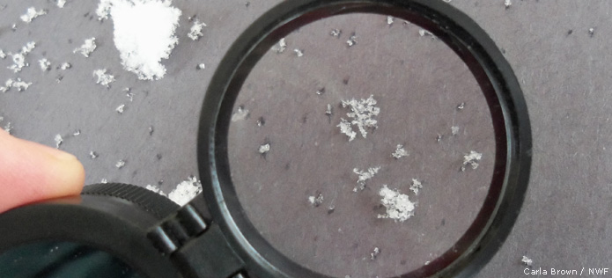
Step 3: Magnify!
- Use magnifying lenses (also important to have them frozen); use a digital microscope like Zoomy inside a cooler in your learning space?

Slide 5
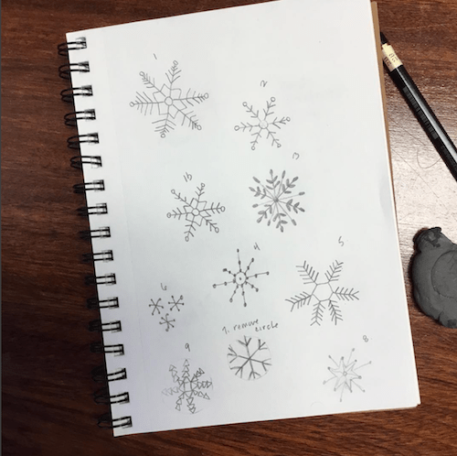
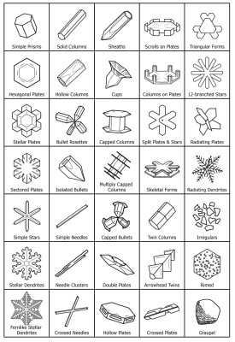
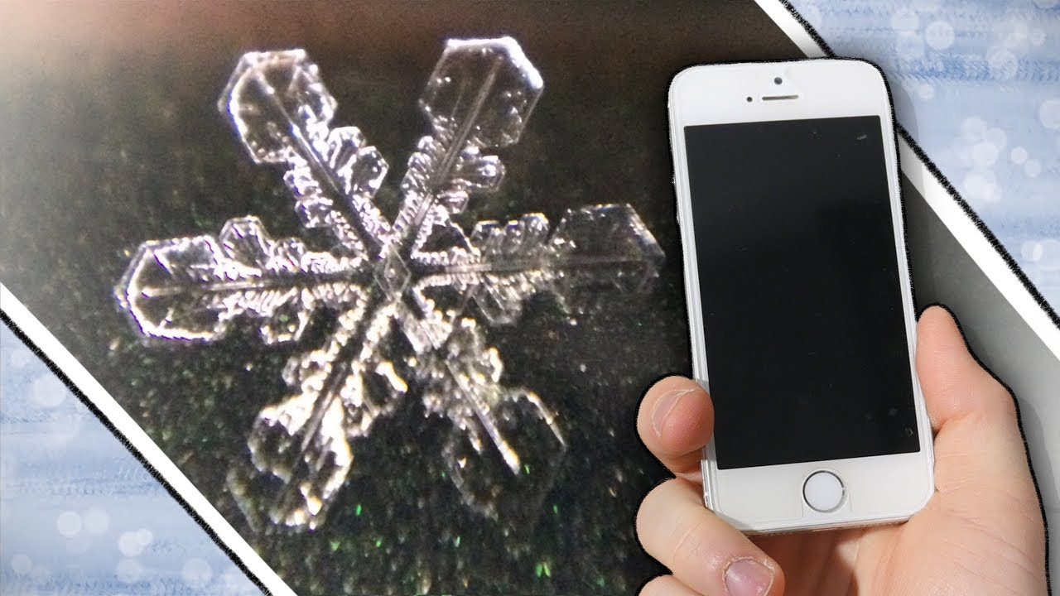
Step 4: Document
- Sketch snowflakes, if warm enough; try snowflake photography; check off snowflake shapes on a chart; or just enjoy looking at them and letting them go!
Notes:
For photography, use the macro setting and take lots of shots. Consider using a macro lens attachment for phones. Try taking pictures through the magnifying glass, if you have someone to hold it for you. For snowflake identification charts check out SnowCrystals.com for the chart shown here, or for older kids NASA has an activity page that includes tallying and percentages for a math connection for older children.

Slide 6
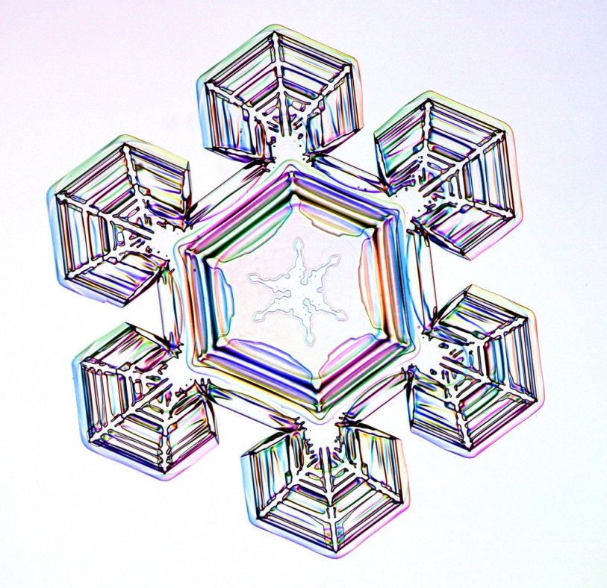
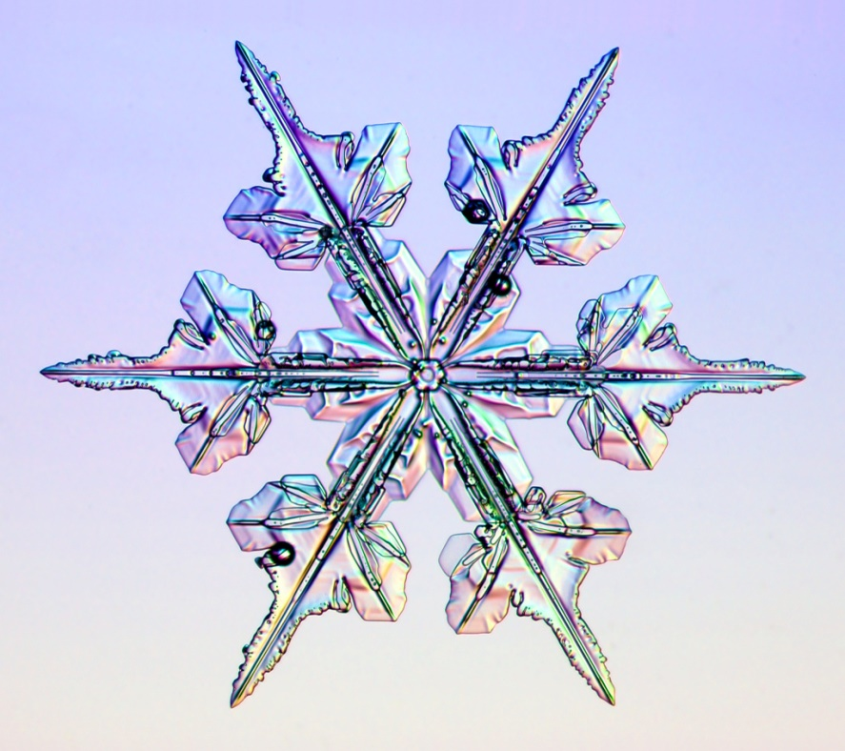
Step 4: Science Connections
- Snowflakes form from tiny ice crystals and grow into different shapes depending
on temperature and moisture (here is a video). The broadest categories of snowflakes are:
Plates
(flat)
Dendrites
(“tree”-like)
Plates and Dendrite flakes most often both have 6 sides
Notes:
Snow crystals are not frozen raindrops; that is called sleet. A snow crystal appears when water vapor in the air converts directly into ice without first becoming liquid water. As more water vapor condenses onto a nascent snow crystal, it grow and develops, and that is when its ornate patterns emerge.

Slide 7
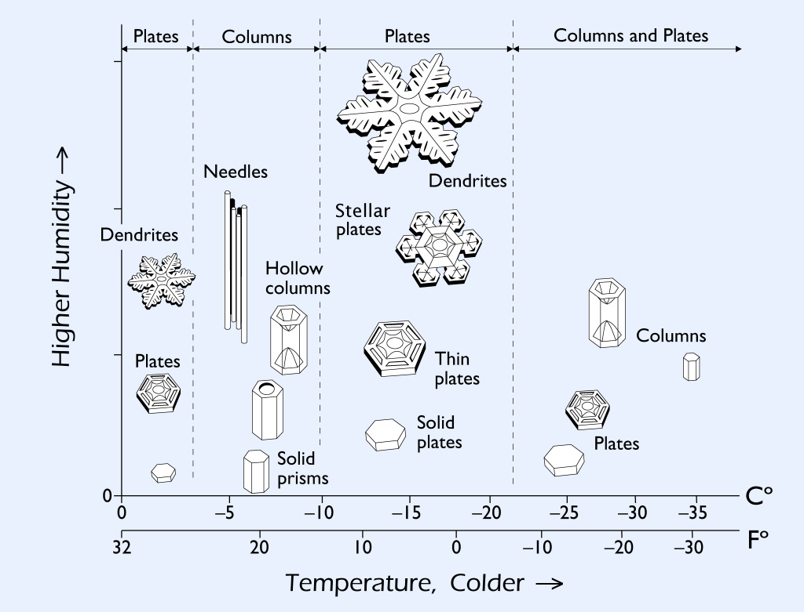
Step 4: Science Connections
- There are also many other shapes—some of them building blocks, some of them more
complex.

Slide 8
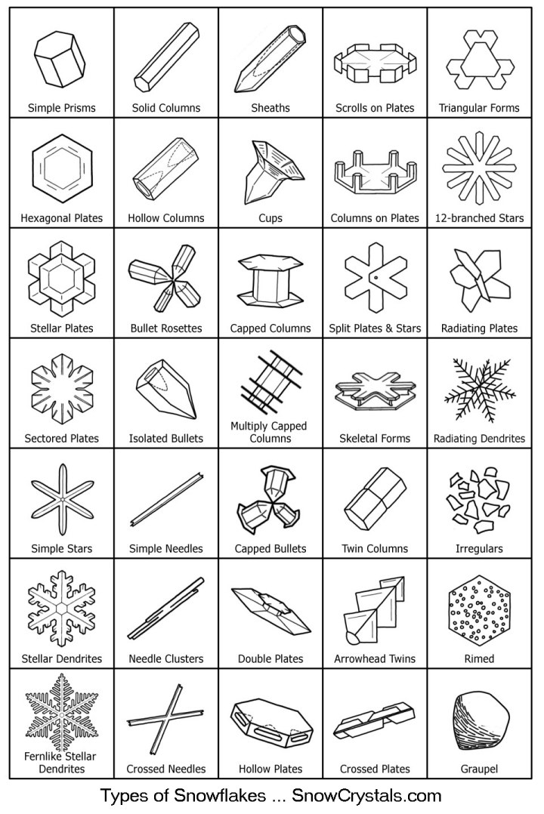
Step 4: Science Connections
- Here is a field guide to snowflakes; for more information visit SnowCrystals.com

Slide 9
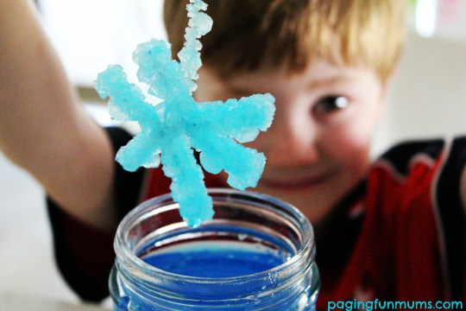
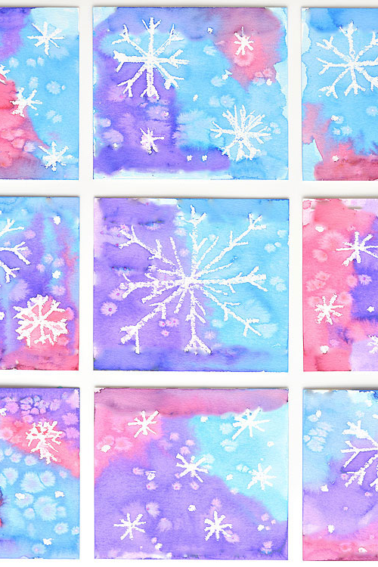
Step 5: Arts Connections
- History, Photography, and Art Projects

Slide 10
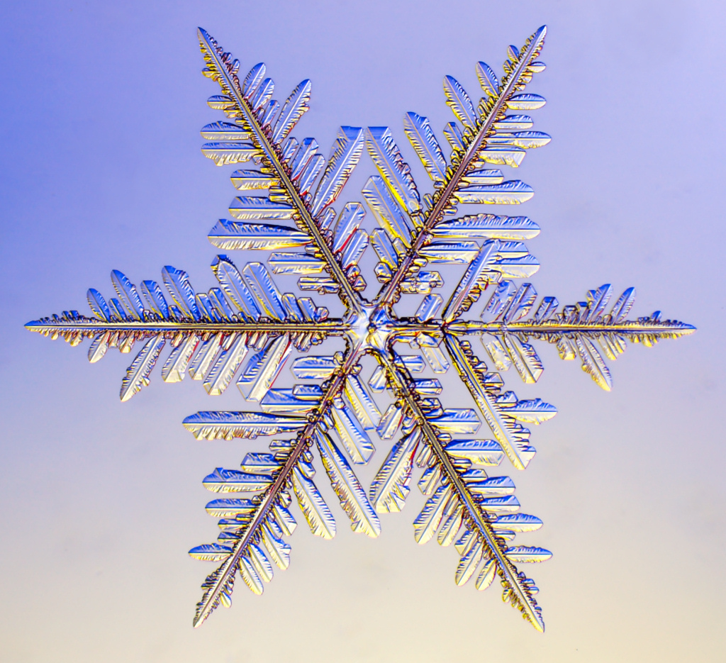
Get out there and Conquer the Cold!
Catch and identify snowflakes with children all winter long!!
List of online resources available on the Manitoba Nature Summit website and also posted in the ZOOM chat box.
Questions?
Want to add something??

