Slide 1
Getting the DIRT on Mud Day
Janet Berezowecki & Chantel Colli

Slide 2
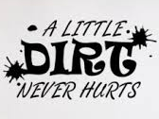
Workshop Overview
Benefits of Mud Play
The First Steps to your Mud Day
Barriers
Implementation Ideas & “The Mud Day Checklist”
Unique Mud Activities & Centres
Documentation
Indoor Mud Play
Questions and Evaluations

Slide 3
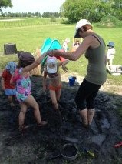
What are the benefits of mud play?
Brainstorm with those at your table:
- Health Benefits
- Social and Emotional
- Cognitive and Language
- Fine and Gross Motor
Notes:
Have participants split into areas as per their tables. (Maybe label tables ahead of time) so that there are a few tables each doing an area of development. Use the large wall sticky notes to post on the walls once brainstorming and sharing is complete. To share, bring up our slides from each area and then ask participants if they have additional ideas to add to the list we present.

Slide 4
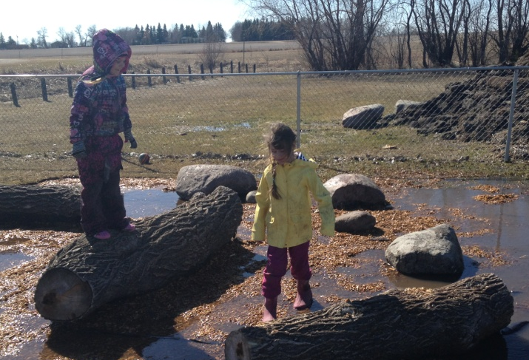
Health Benefits
Mud Play...
Reduces obesity (CDC, 2008)
Reduces Vitamin D Deficiency (AAP, 2009)
Enhances mental health, lowers stress levels and increases relaxation (Kuo, 2004 & Lowry, 2007)
Builds immune systems (Platts-Mills, 2005)
Reduces asthma and autoimmune disorders (Platts-Mills, 2005)
Notes:
Were there any additional health benefits that were brought forward at the table discussion?

Slide 5

MYTH OR FACT?
Children who are exposed to the GERMS that are found in dirt have a higher risk of cardiovascular inflammation as they grow into adulthood.

Slide 6
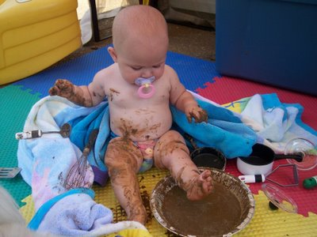
MYTH!
Children who are exposed to and play in dirt during infancy and childhood have a decreased risk of cardiovascular inflammation in childhood, thus decreasing the risk of heart attack and stroke.
(Channick, 2010)

Slide 7
MYTH OR FACT?
The staphylococci bacteria that is found in dirt and mud increases the skins ability to heal itself.

Slide 8
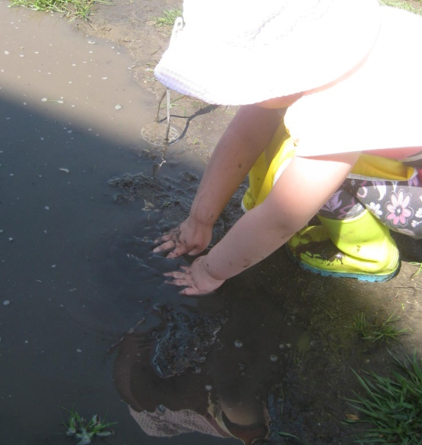
FACT!
The staphylococci bacteria assists the skin with its own natural healing ability through the prevention of inflammation.
(BBC News, 2009)

Slide 9
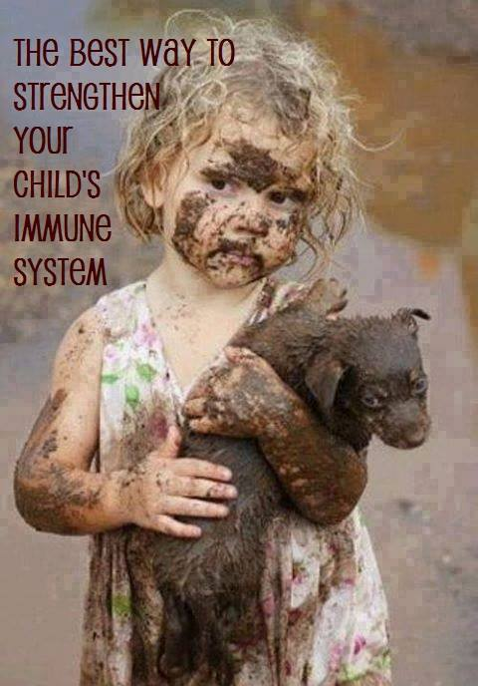

Slide 10
Social and Emotional Benefits
Mud Play...
Allows for cooperation and team work
Provides endless opportunities for sharing of equipment, space and Mud!
Offers a canvas for creative thinking and imaginative stories – It’s Open-Ended!
Gives freedom to explore thus provoking pleasure and pride from success in experimentation and confidence in new skills
Notes:
Mud is a very forgiving medium that includes the ability to smooth, squish or stomp and start over, giving children the opportunity to make changes, improve skills and feel proud of the work they have accomplished.

Slide 11
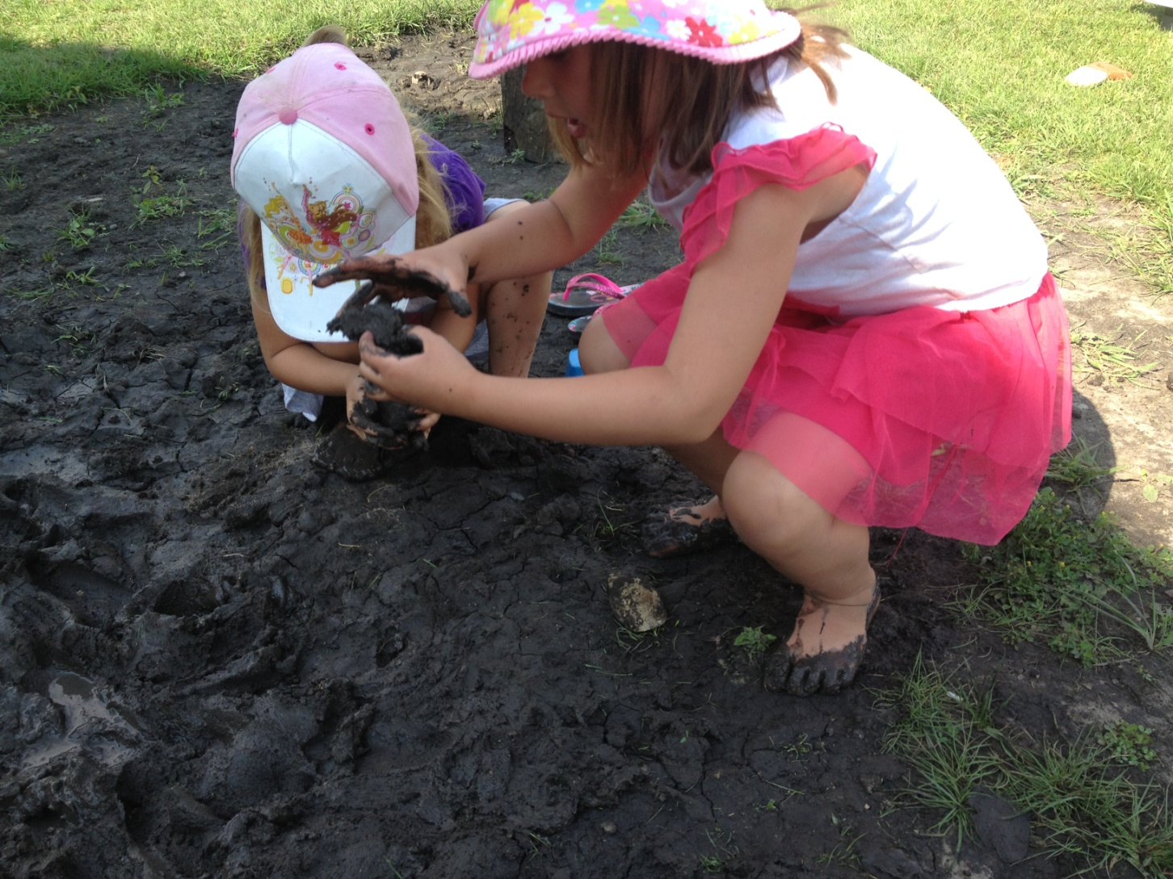
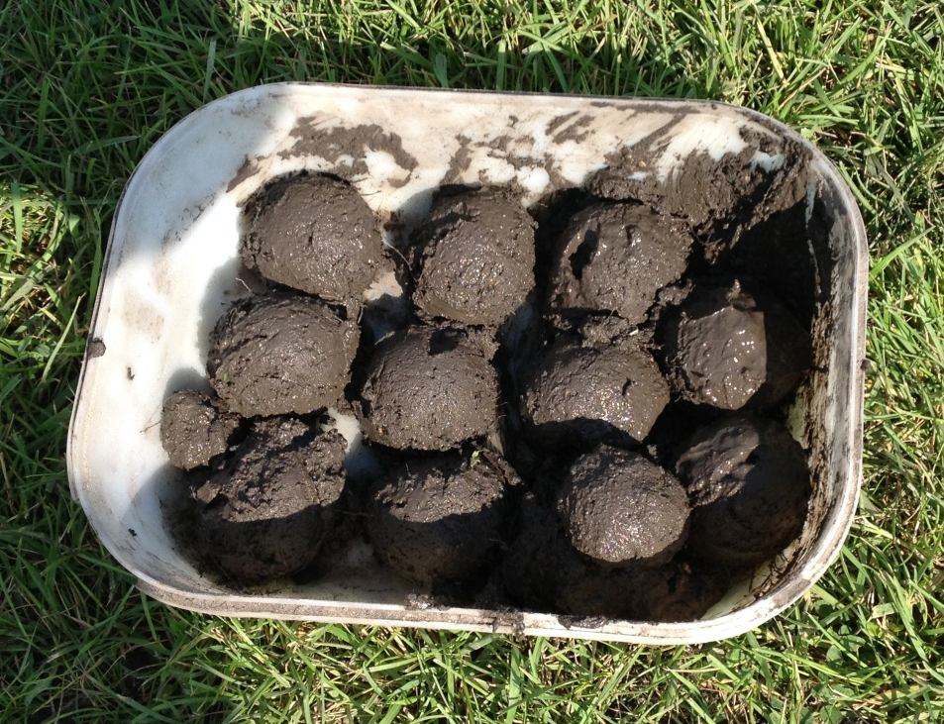

Slide 12
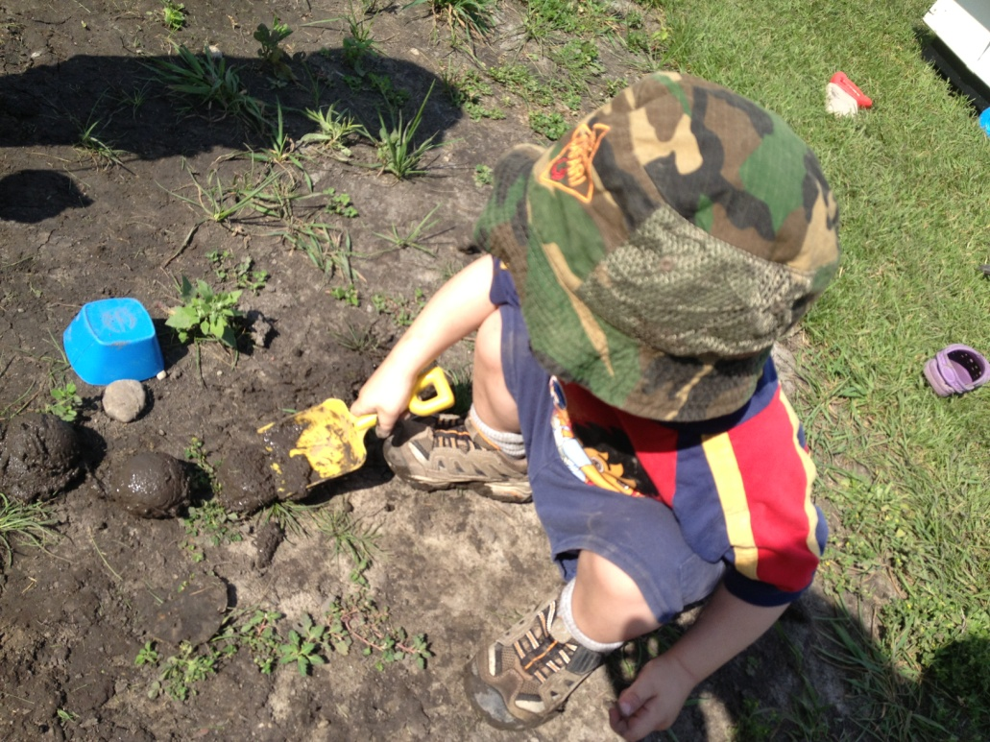
MYTH OR FACT?
Children who spend time in Dirt are better prepared for the classroom.

Slide 13
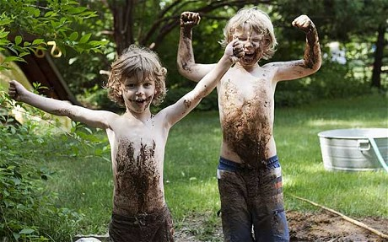
FACT!
Direct contact with soil improves mood, reduces anxiety and facilitates learning all of which are vital for success in the classroom.
(Science Weekly, 2010)

Slide 14
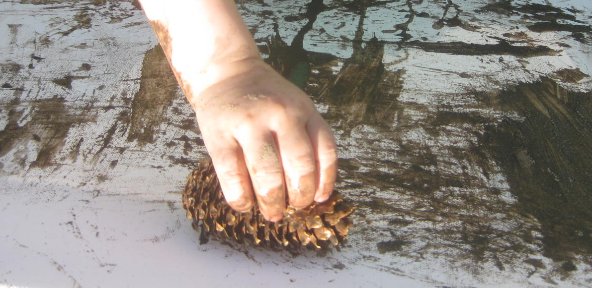
Cognitive Benefits
Possibility for a variety of Experiences:
Sorting & Classifying
Creating & Decorating
Labelling & Naming
Sharing & Taking Turns
Exploring, Enquiring & Predicting
Transforming & Changing
Notes:
Through clean up of the area and washing of the used items afterwards, children learn respect for the area. Offering buckets of soapy water, clean water and drip trays allow children this experience.

Slide 15
Language Benefits
Possibility for Expanded Vocabulary using words such as:
Describing properties: smooth, circular, warm, squishy, stony
Describing action: garnish, whisking, boiling, decorating
Describing tools: sifter, spatula, tongs
Describing relationships: cooperate, team work, sharing, giving
Describing quantity: measure, add, remove, weight
Notes:
Adding items including recipe books, cards and holders along with pens/pencils is a great way to expand on literacy skills. Also consider laminating simple picture recipes and offer white board markers so children can use recipes and mark ingredients they have added.

Slide 16
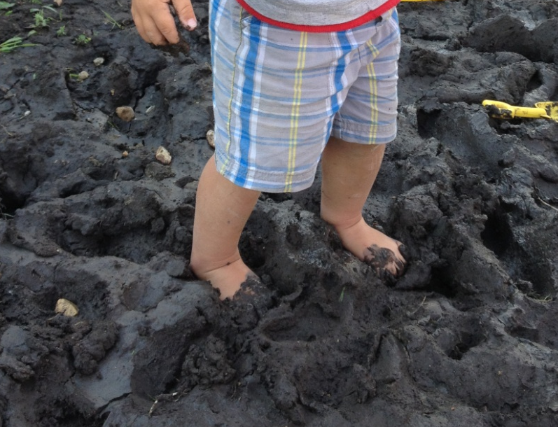
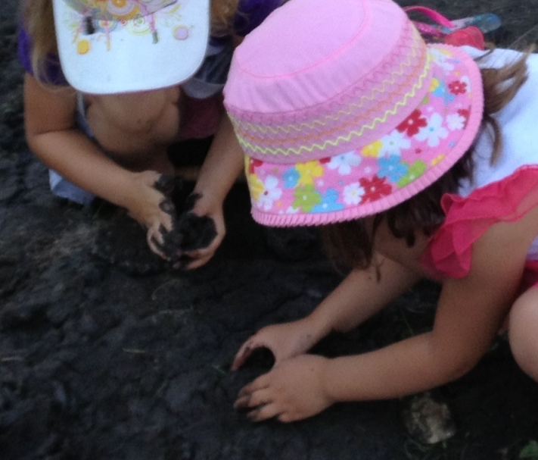
MYTH OR FACT?
Mud play is a method of offering children tactile experiences, which are vital to brain development.

Slide 17
FACT!
Mud play allows children to use their hands, feet and bodies to explore an element of their natural world. This tactile experience is a method of gaining information relating to the medium and allows children to gain information that relates to the properties of mud, their reactions and the reactions of others. This exploration and intake of knowledge is an important piece of brain development.

Slide 18
MYTH OR FACT?
Staff should take a “back seat” to allow the children the opportunity to freely explore without any adult involvement.

Slide 19
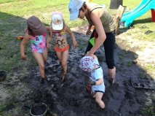
MYTH!
Staff are an excellent resource for children. Although you don’t want to lead their play, you should be available to offer new vocabulary and capture teachable moments, as well as to observe and determine what items you could provide to further enhance the play scenario.

Slide 20
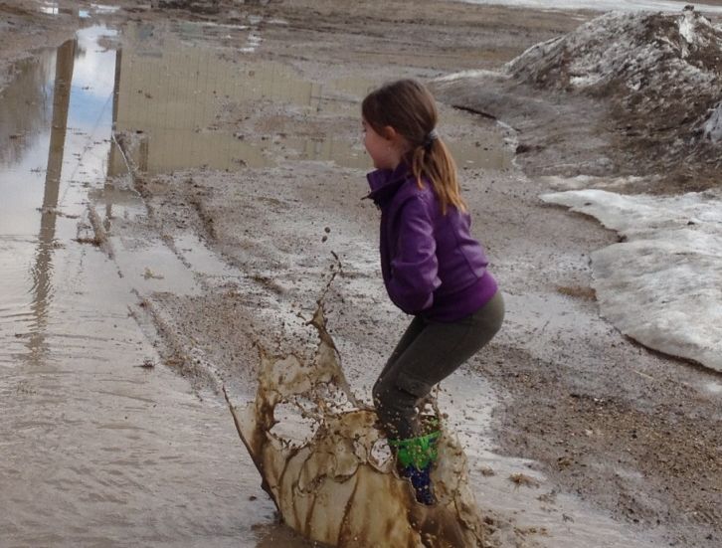
Fine and Gross Motor Benefits
Mud Play...
Increases hand-eye coordination
Allows children to test their physical
limits
Encourages exercise and movement
Offers opportunities for large motor development through carrying, scooping, digging, balancing, pulling, stomping
Offers opportunities for fine motor development through sculpting, patting, smoothing, squishing, squeezing

Slide 21
Role of the ECE
Observe, strive to understand and document play experiences
Supply useful language to label actions, equipment and feelings
Set up the area and continue to supply materials to enhance play
Be a play facilitator and enabler
Interpret the benefits of mud play for development and be an advocate to other adults

Slide 22
MYTH OR FACT?
It is important not to offer additional materials to children while they are playing in the mud as it takes away from children’s open-ended learning and exploration.

Slide 23
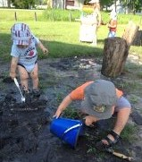
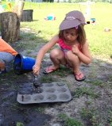
MYTH!
It is important to offer materials to children that allow them to expand on their mud exploration. Items that allow children to measure, scoop, pour, squeeze, etc. are an excellent way to begin conversations and labelling of actions and encourages development of the whole child from physical to emotional.

Slide 24
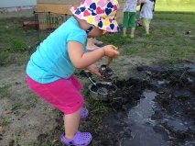
I see there are benefits...Now what?
Your First Steps:
-Gather your data
-Introduce the idea to the rest of your team
-Create an action plan for the day
-Notify your parents
Notes:
Gathering data: you are going to want to have some background knowledge in your mind on the benefits or reasoning of why you would like to host a mud day. Can you find articles relating to Mud Day or Mud Play that offer positive views on the benefits of mud? What is your internal motivation for hosting a mud day? Think about who on your team might be the most difficult to bring on board with your idea? What kind of information can you offer them that might change their minds?
Introduce the idea to the rest of your team: This may be brought up at a staff meeting where all team members can discuss the information you have uncovered, or a method that works for your team and facility. Evaluate the reactions, listen to the feedback. Are the members of your team excited and involved? Are they apprehensive?
Create an action plan: choose a date, determine who is responsible for which aspects of the day, at what time will you create the mud, how will you ensure that you have materials on hand for children to use to expand their play, at what time do you need to clean up, who will do this, who is going to take pictures, document what children are saying, create the documentation for parents?
How are you going to notify the parents and how will you give them the information? Email, white board, notes home, etc?

Slide 25
A Note Home...
Date and time
Background on International Mud Day
Benefits of mud play
Items you’d like parents to supply

Slide 26
Continued...
Your plan for the day (times to be in the mud, times to be cleaning up)
Information on additional activities (ie. Worms & Dirt for snack!)
Alternate activity should they decide their child will not participate (ie. books, games & puzzles, outdoor dramatic play, etc.)

Slide 27
Additional Activities
Story Tables
Sponge Target
Invitations for Learning (ie. shell table, pig play bin)
Brown Cornstarch Magic
Mud and Dirt Songs, Poems and Finger Plays

Slide 28
Dear parents,
On June 29th, CDELC Inc will be holding its second annual “Mud Day!” Since its several years ago, Mud Day and knowledge of the benefits of mud play have been fast spreading into children’s programs across the world. International Mud Day began as a celebration of two communities in Nepaul and Australia during which time children were allowed to explore, create and enjoy one of life’s treasures-Mud. In order to celebrate International Mud Day, CDELC Inc will be participating through mud play, songs, books and finger plays as well as by offering additional activities and invitations with the Mud Day theme.
Mud play will begin at 10:00 and continue until 11:30 when we clean up for lunch. Children will continue with mud play following afternoon snack until 5:00p.m.
There are many benefits that come through mud play and exploration that cover all of the developmental domains and assist with the development of the whole child. Some of these include; gross and fine motor development, opportunities for sharing and cooperation, introduction to new language and descriptive words, emotions of pride and joy and opportunities for problem solving and prediction, among many others.
We ask that families provide old clothes that are able to get dirty, or on old swim suit as well a hat that the children can wear in the mud. Staff will work with children to assist them in clean up and changing clothing as they see families arriving at the centre for pick up time and ask that you assist with this process by picking up between 11:45- 12 noon and 5:00-5:15 if possible. Please allow for a few additional minutes at pick up time as we may require your help to get your children cleaned up and changed.
We are very excited for the opportunity to engage in mud play with your children and look forward in the coming days to sharing photos and documentation of the excitement and learning that takes place through this valuable exploration. If you would to join in the fun or have any questions, please contact me at the Centre.
Sincerely,
Chantel

Slide 29
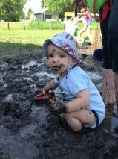
Barriers
Parents
Other Staff
Environmental
Indoor Space
Public Health
Staffing and Prep Time
Safety
Notes:
Environmental – ie. Outdoor tap to use in the creation of mud or use for clean up
Playgrounds that do not have “mud pits”
Weather
Indoor Space – ie. Clean-up area, carpet, bathrooming muddy children?
What safety precautions might you have to take?
Any others?

Slide 30
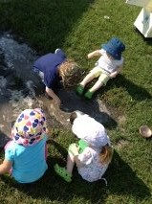
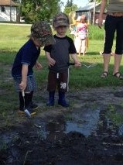
Implementing Your Mud Day!!!

Slide 31
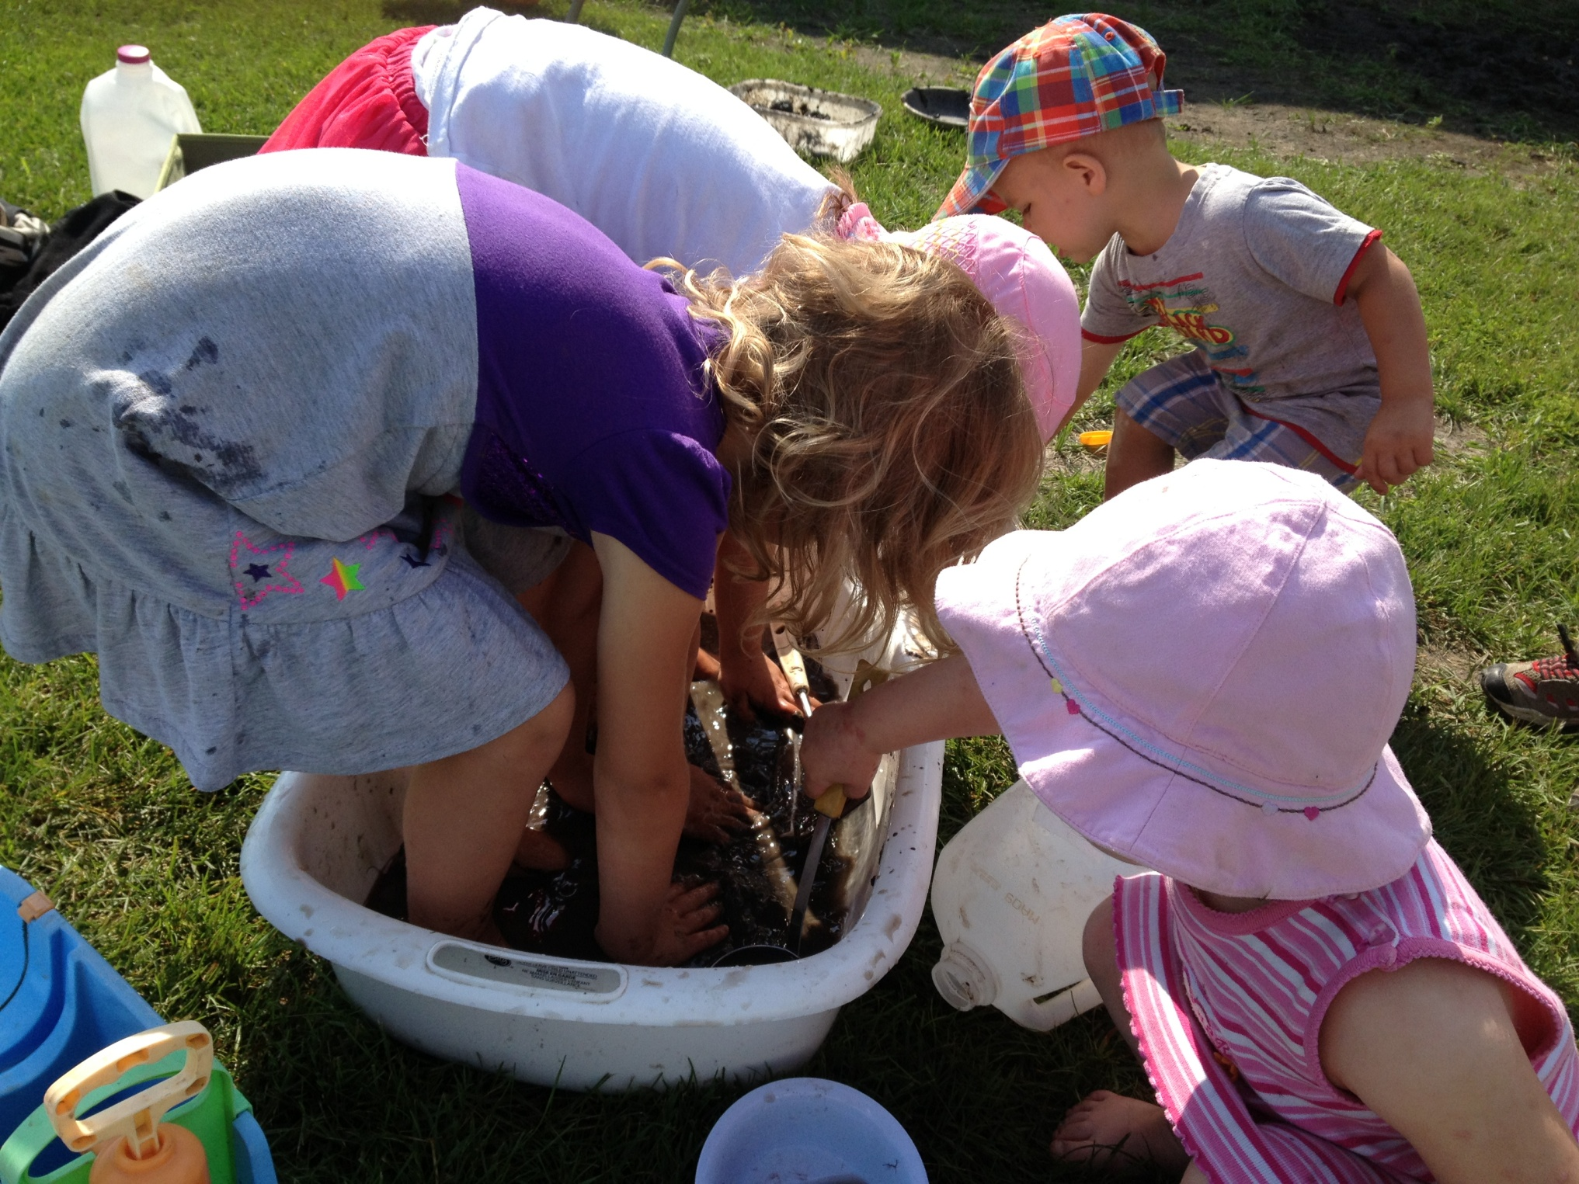

Slide 32
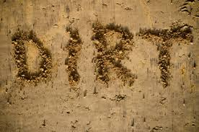
ACTIVITIES YOU CAN IMPLEMENT WITH...

Slide 33
Break into groups based on the ages you work with
Brainstorm 2 activities or mud play areas that you would include in your mud day.
How are the activities age appropriate?
What did you need to consider when planning this?

Slide 34
From Dirt to Mud and Back Again
What happens when you add water to dirt?
Does adding water change how it looks? Smells? Feels?
What might happen if we place the mud into the sun?
How did it change? Why do you think this happened?
Notes:
This can also be implemented using sand. A different variation of this activity would be to use a variety of different soil types (ie. black dirt, sand, clay, gravel, etc.) and add water to each in a container that has holes in the bottom (ie. flower pot), allowing the children to explore the properties of each. How does each change with the addition of water? Why might this be? Talk about the particle sizes, absorption, etc. How do they smell, different? The same? Which one will dry out fastest in the sun – graph their predictions.

Slide 35
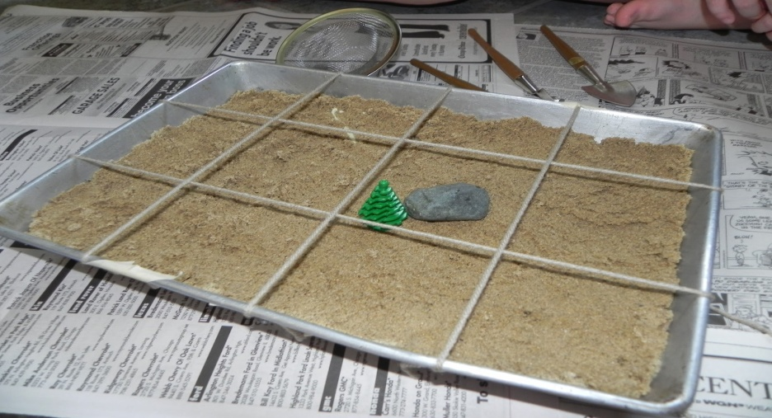
Dirt Pit Dig
Indoor or Outdoor
How might loosening the dirt change how it feels?
Are there any ideas on how this would assist with making mud?
How can we document the items that we have found?
What is the largest item we found? Smallest?
Notes:
Before adding water to the mud pit or table, use as an archeological dig site. Stake out the area using popsicle sticks and string. Offer children brushes, shovels, sifters, etc. Collect and discuss your findings.
You can plan for this ahead of time by hiding items in the mud pit during a rain (ie. sparkle rocks, jems, etc) make a treasure map to be used on mud day to find the “treasure!” Once the treasure has been uncovered, start the prep work for the mud and let the fun continue!

Slide 36
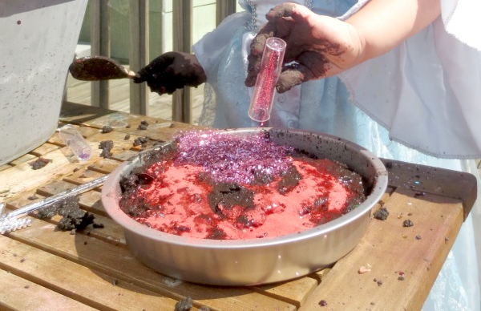
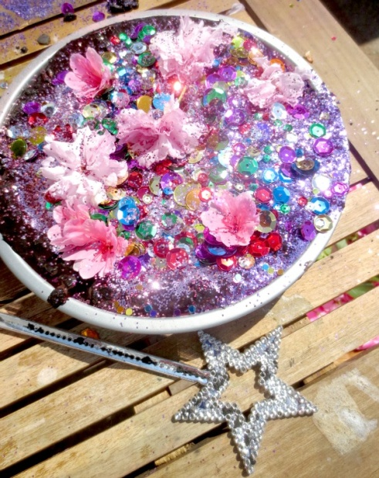
Prince & Princess Mud
Ingredients:
- Mud
- Colored sand, paint, glitter paint
- Shells, glitter rocks, glitter pine cones
- Gems and beads
- Tiaras and Crowns
- IMAGINATION!
Notes:
This would also be great indoors if you had a drop sheet. If you have recycled pie plates children can allow their creations to dry and use them as cakes, etc in the outdoor dramatic play space after that.

Slide 37
Building a Mud Hut
- Offer the children the challenge of creating a structure using the sticks, mud and twine
- What worked while creating the structure?
- How did they need to work together to be successful?
- Discuss countries where people live in huts of mud, how would their life be different?
- Who can live in the hut we made?
Notes:
Collect sticks and branches
Have Twine on hand

Slide 38
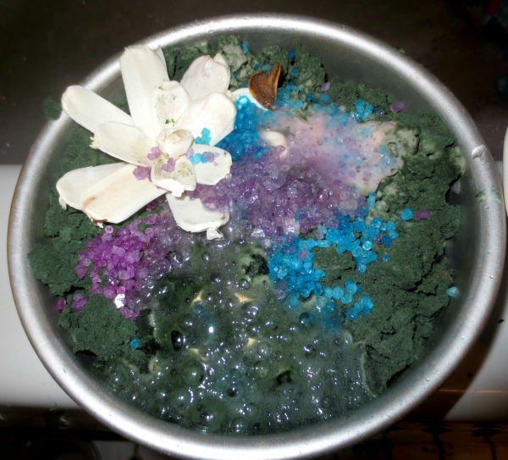
The Real “Magic Mud”
- Create a mixture of paint or food coloring and baking soda
- Allow children to use this in their mud play (goes well with the prince and princess mud)
- Offer the children syringes,
measuring spoons and pouring
materials as well as cups of
vinegar
- Watch for the Magic!
Notes:
Another variation:
Mix baking soda, black food coloring and a small amount of water. Feels like real mud! Decorate with kool-aid, colored epsom salts, sequins, soap flowers, paint in syringes or in icing bags and with gems, flowers, etc. At the end, give children vinegar in pouring cups, syringes, etc and allow them to see the effects!

Slide 39
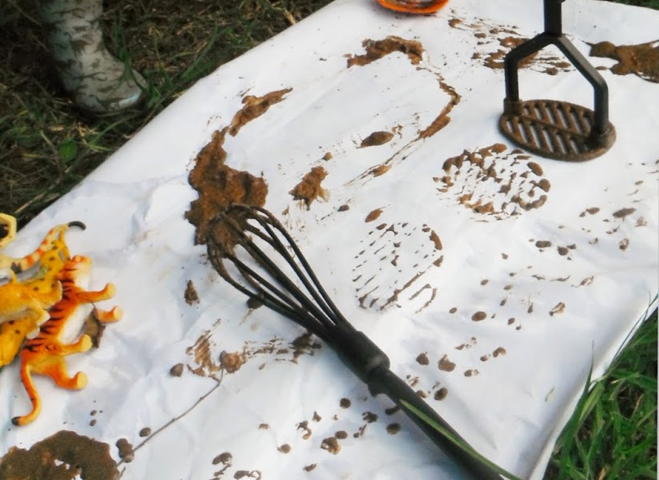
Mud Canvas Painting
-How do different items create different prints on the canvas?
- If varying amounts of water are added to the cups does it behave differently on the paper?
- What happens if you add
ground chalk, food coloring or paint?
- How can you use your body
to create different prints
and markings?
Notes:
Offer items including:
Sticks
Pine cones and needles
Shells and stones
Leaves
Cups or pie plates of mud
Food coloring, ground chalk, paint, kool-aid
Canvas or paper on the fence
Smocks if desired

Slide 40
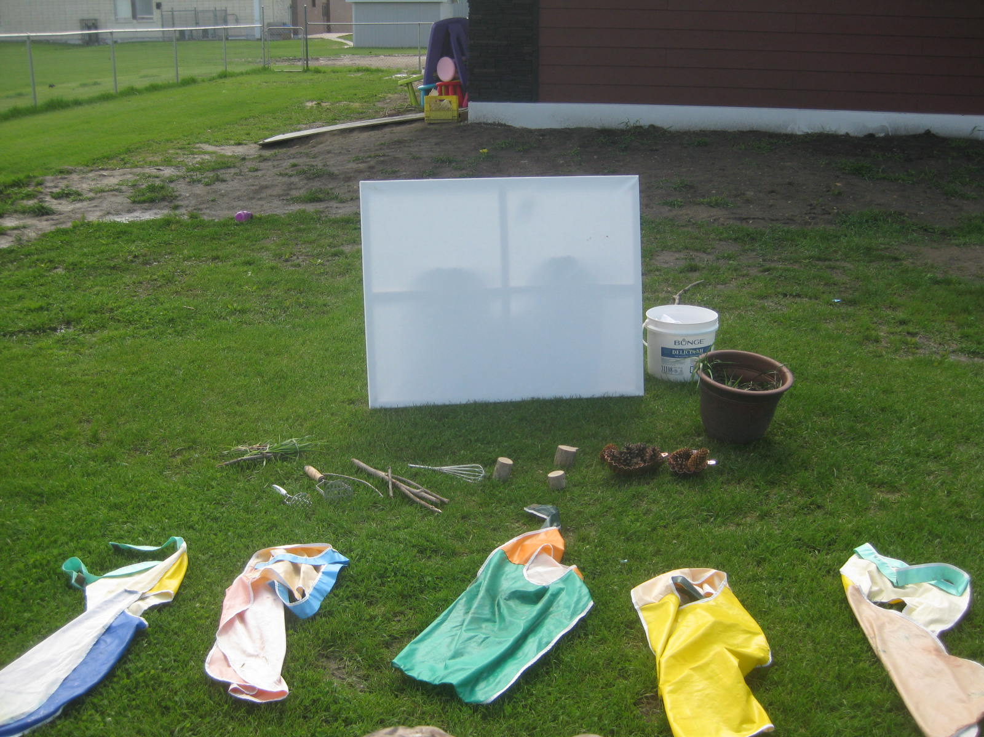
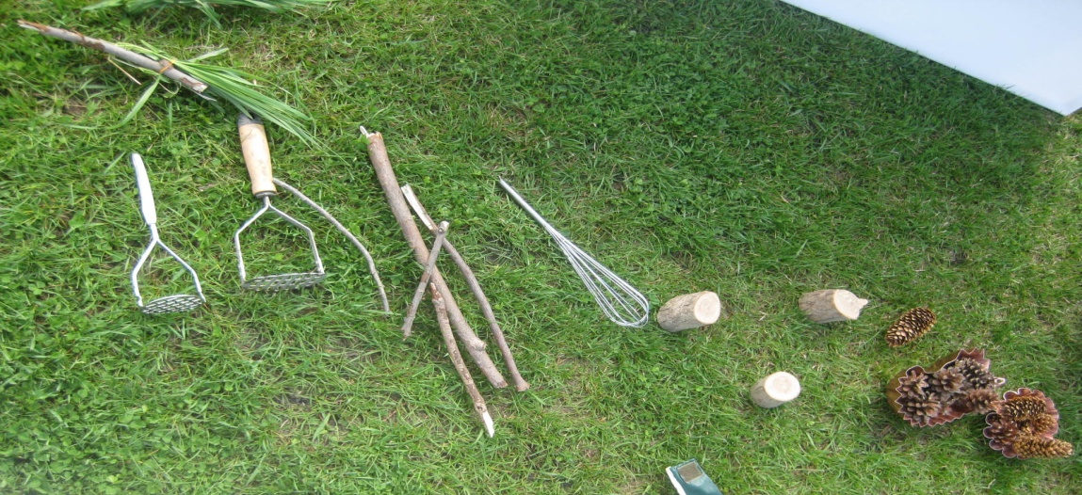
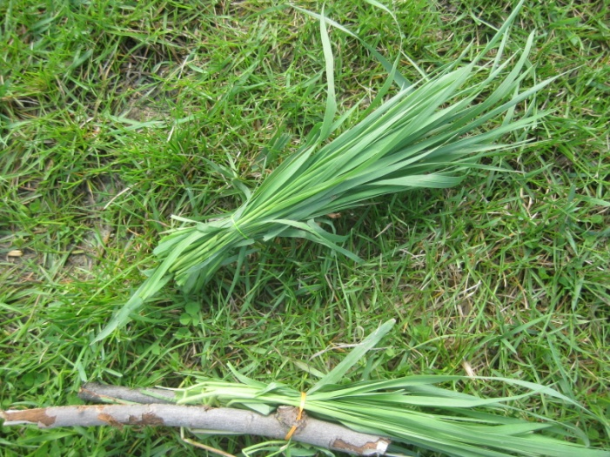
Setting up the Activity

Slide 41
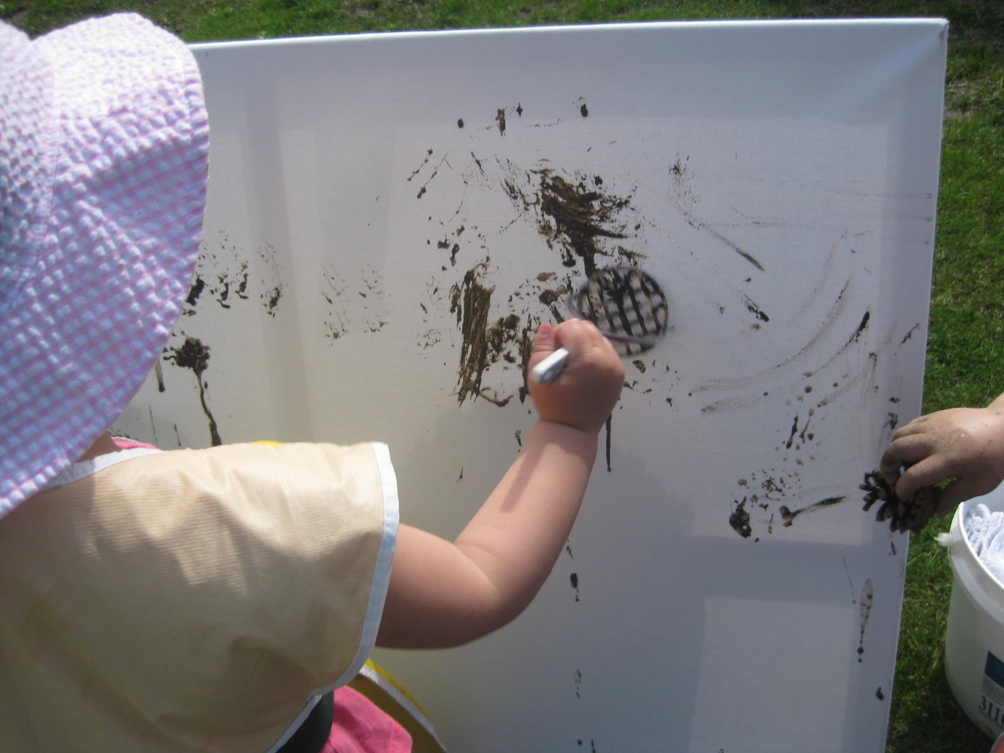

Slide 42
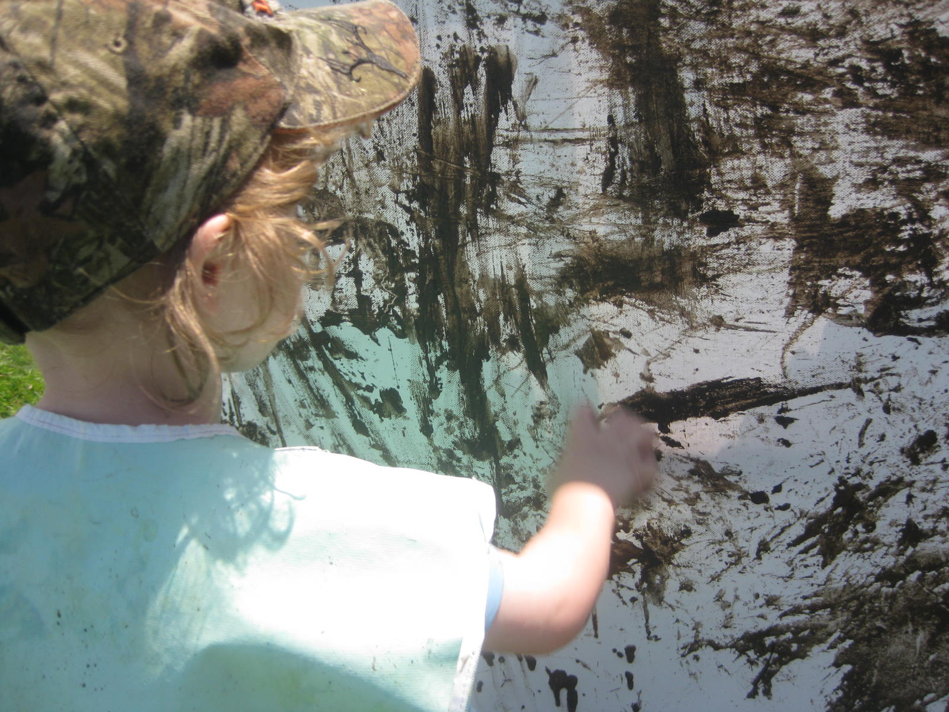

Slide 43
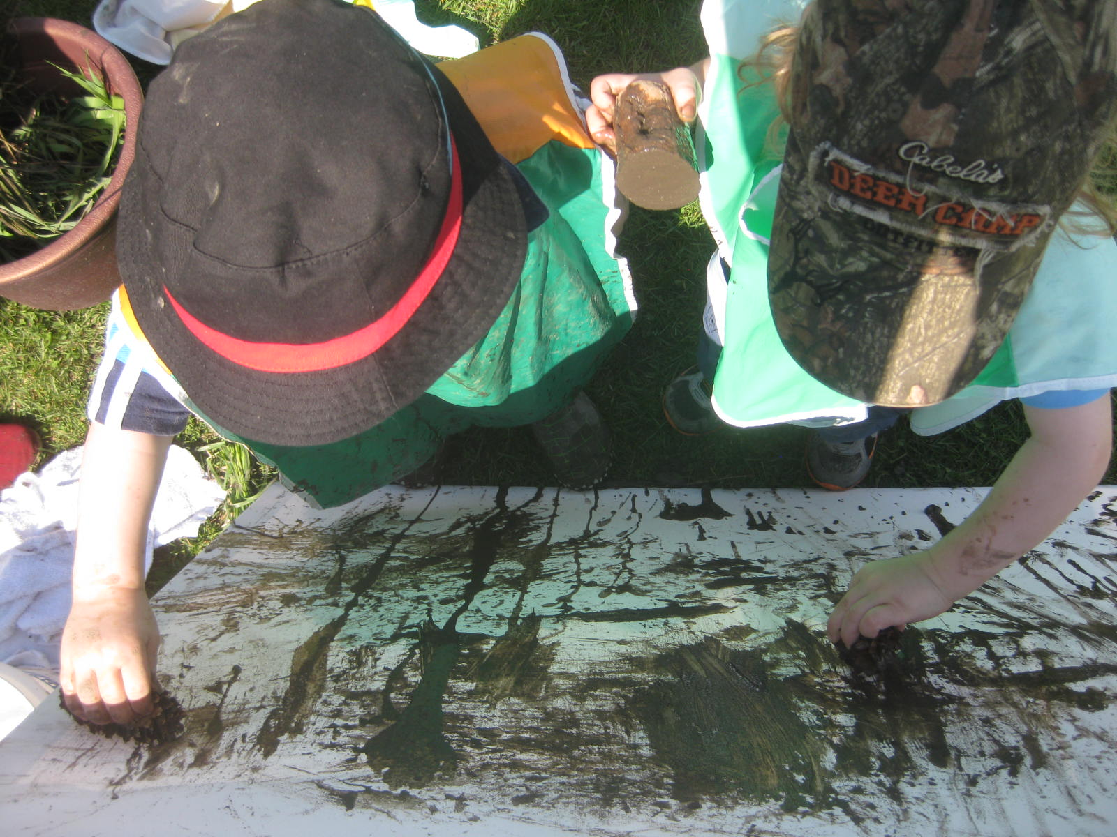

Slide 44
What Can You Add to Mud?
Natural Items
- Leaves, stones, shells, colored rocks, sand, gravel, twigs, pine needles, pine cones
Utensils
- Pots and pans, spoons, baking tins, ice cream scoops, jelly molds, ice cream trays, bowls
Extras
- Salt/pepper shakers, spice jars, beads and gems, ground chalk, food coloring, animals, aprons

Slide 45
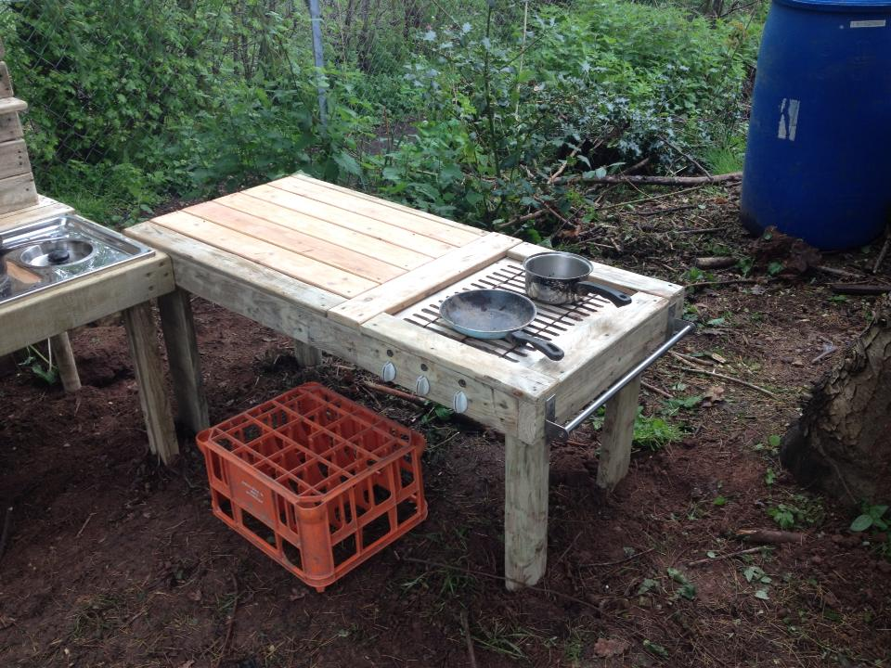
Creating a Mud Kitchen

Slide 46
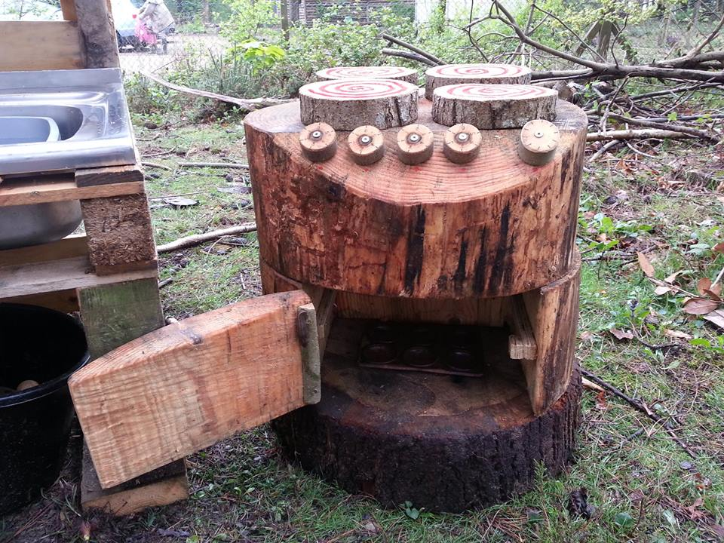

Slide 47
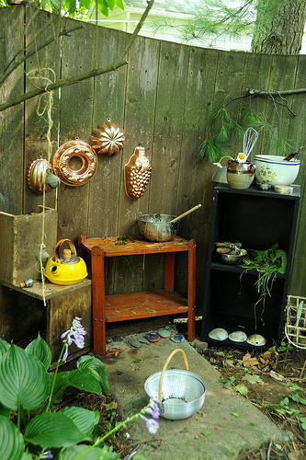

Slide 48
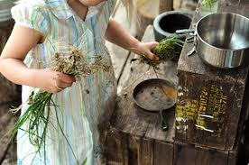

Slide 49
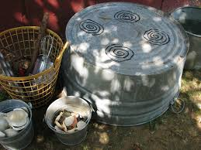

Slide 50
Mud Day Checklist
Have I...
gathered resources on the benefits of mud play?
shared the resources with my team?
created an action plan of activities to offer?
made a list of items we would like to have on hand?
shared the plan and important information with the parents?
gathered the materials?
prepared clean up materials in advance? (water, cloths, clothes, etc)
checked the area for any safety concerns?
included the children in making the perfect mud?
allowed children to explore, engage and create?
supported children’s learning and play?
taken pictures/videos to share with parents?
created and displayed the documentation
made notes on changes for next year?

Slide 51

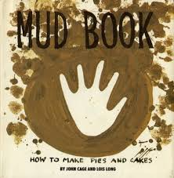
Books that go great with Mud!
“Mud Puddle” – Robert Munsch
“Little Blue Truck” – Alice Schertle
“Frog in a Bog” -
“Growing Vegetable Soup”
“Mud” – Mary Lyn Ray
“Stuck in the Mud” – Jane Clarke
“Mud!” – Wendy Cheyette Lewison
“The Mud Monster” – Rosemary Billam

Slide 52
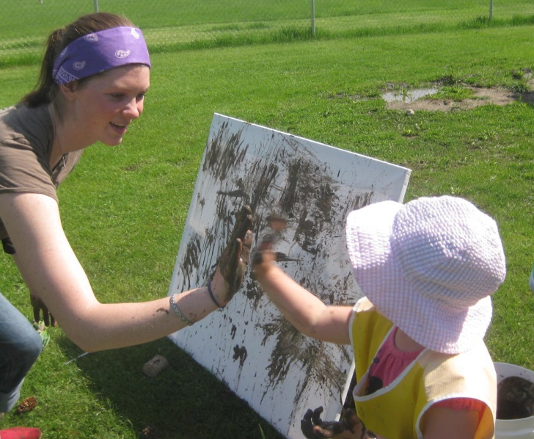
Document, Document, Document!!
Pictures or Videos
Photo books
Posters
Digital frames
Written Observation Notes
What are children saying and doing
Key words or phrases
Highlights of conversation “It feels sticky!”
Notes of developmental skills learned
Ie. Turn taking, cause and effect, hand eye coordination
Notes:
Pictures, ideas for write-ups, words to add, key points to share with parents
Different methods of documentation – Picture Frames, Write-ups and Pictures, Digital Frames with pics and Video, Individual child write ups and muddy hand prints, etc.

Slide 53
Mud...Not just for outside!
How can you implement mud play in your centre?
Brainstorm Invitations for learning that you could implement with the Centre
Invitations on the Tables
Notes:
Indoor Mud Play

Slide 54

Resources - Books For Educators
“15 Minutes Outside” – Rebecca P. Cohen
“The Green Hour” – Todd Christopher
“Last Child in the Woods”
– Richard Louv
“i love dirt!” – Jennifer Ward

Slide 55
Resources - Articles and Websites
“The Dirt on Dirt” – National Wildlife Federation
“Making a Mud Kitchen” – Jan White
“play in mud this summer” – Kerala Taylor, Kaboom
NU Study: Dirt’s Good for Kids – Robert Channick
Growing A Jeweled Rose – Blog by Crystal Underwood
Fireflies and MudPies.com

Slide 56
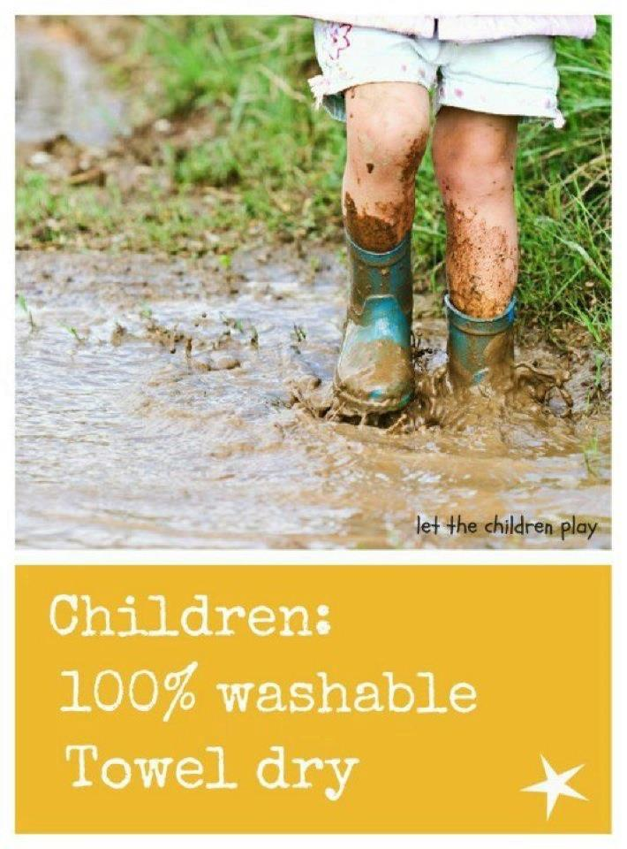
Questions & Evaluations

